Slide 1
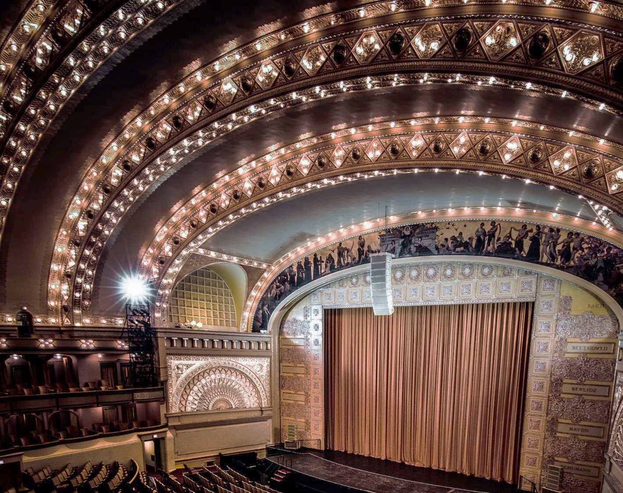

Welcome to the Auditorium Theatre
Virtual Tour

Slide 2
The Auditorium Theatre is available for performance and private event rental.
Built in 1889, the Auditorium Theatre is a National Historic Landmark theatre located in the heart of Chicago’s Loop. Make your event unforgettable with the classic beauty and drama of a Golden Age. A stone’s throw from Buckingham Fountain and steps from Michigan Avenue and Millennium Park, the Auditorium Theatre has been a fixture in Chicago’s arts and culture scene for 130 years. From intimate lobbies and lounges to the breathtaking stage, you’re bound to fall under its spell. The Auditorium Theatre is the perfect setting for:
Concerts & Performances
Lectures
Meetings & Conferences
Private Receptions
Parties & Galas
Graduations
And much more!
We hope you will consider the Auditorium Theatre for your next event. For more information on how to rent the Auditorium Theatre, please visit our website:
www.auditoriumtheatre.org/the-building/rent-the-auditorium/

Slide 3
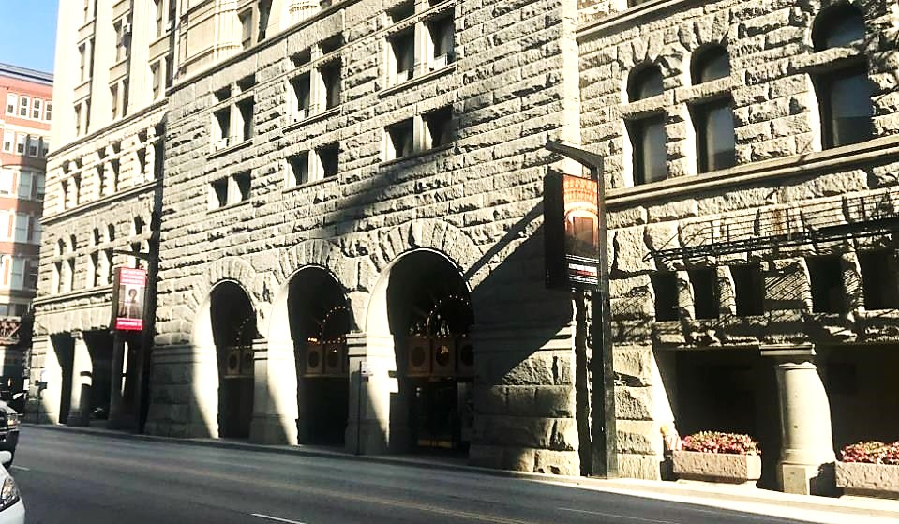
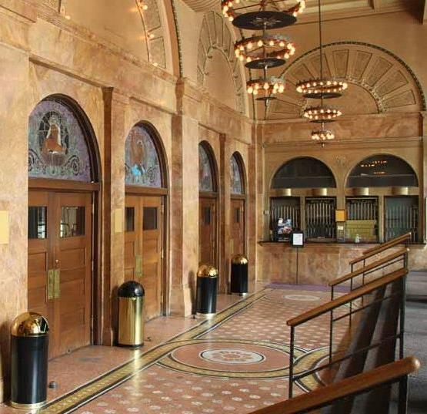
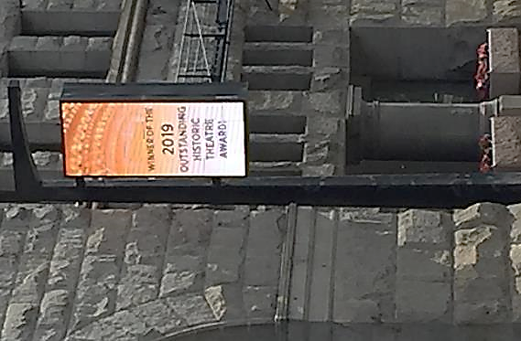
Street View & Ticketing Vestibule
Auditorium Theatre main entrance located at 50 East Ida B Wells Drive between Michigan Avenue and Wabash Avenue in downtown Chicago.
Accessible entrance located just west of the main entrance on Ida B Wells Drive.
Digital marquees located on busy Ida B Wells Drive, available day of show to promote your event.
Ticketing Vestibule features Will Call and day-of ticket purchase windows.
https://theaud.us/streetview
https://theaud.us/vestibule

Slide 4
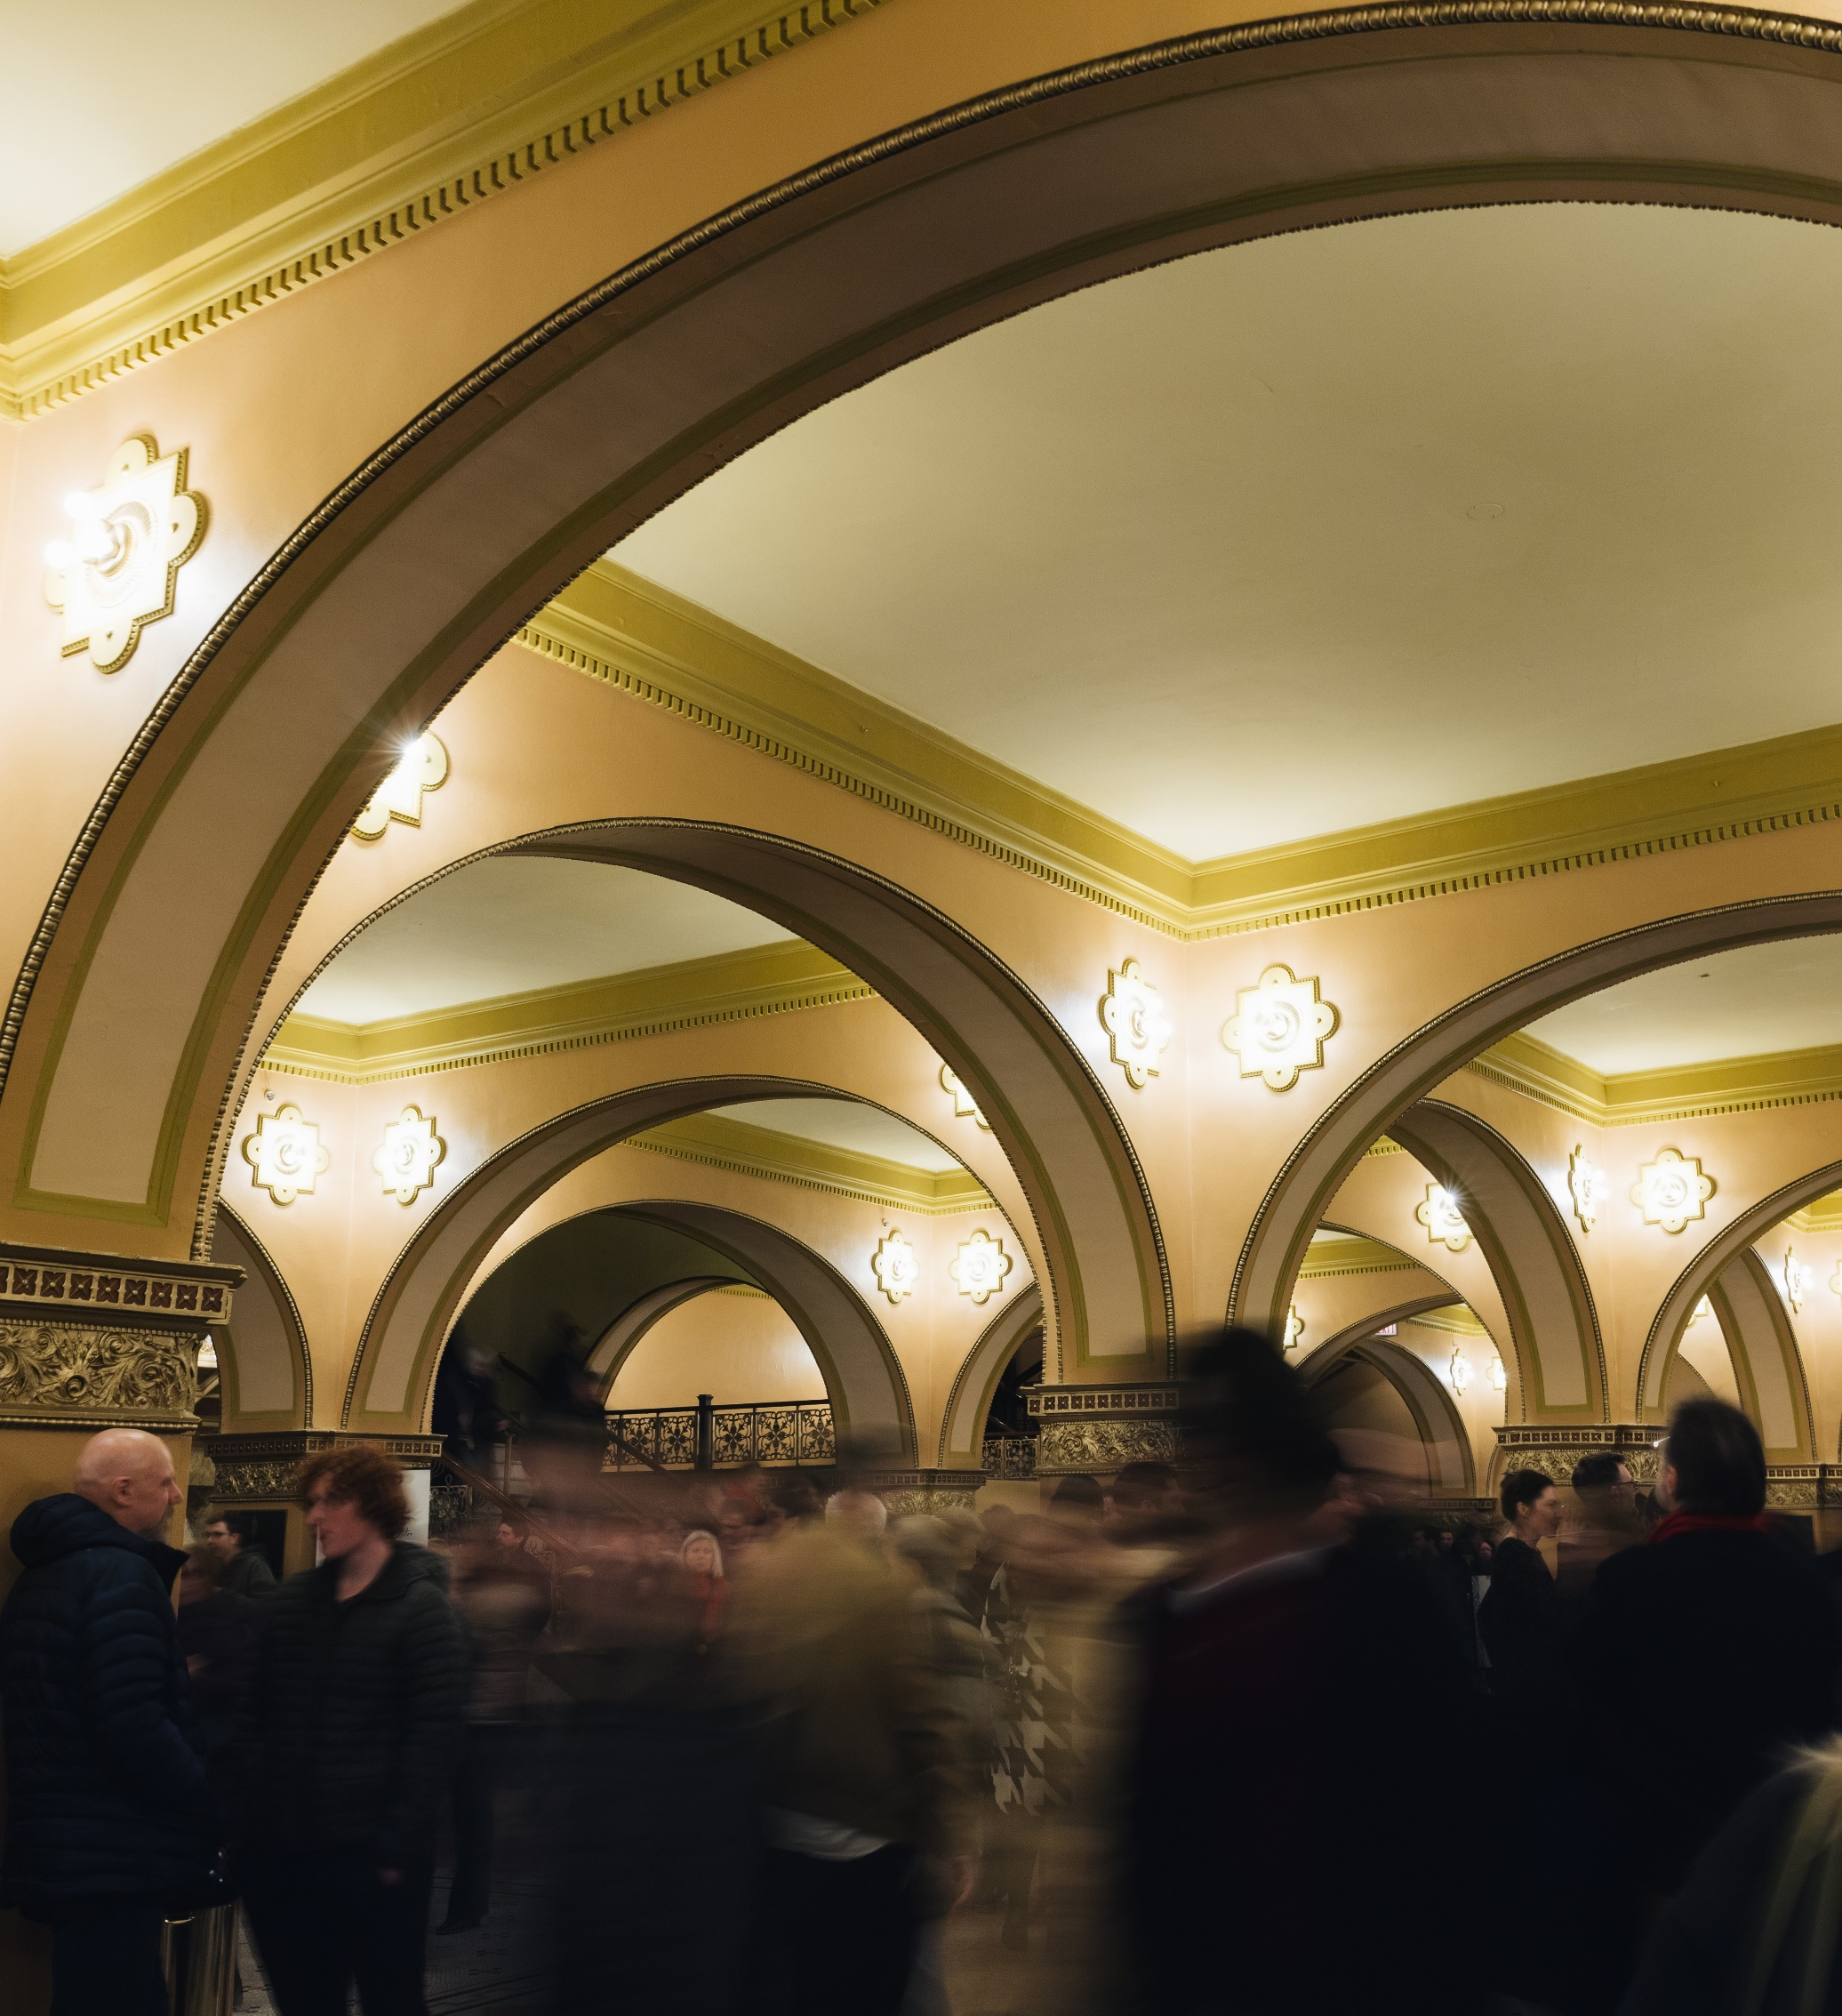
Main Lobby
Reception Capacity: 500
Seated Capacity: 200
Dedicated areas for concessions and merchandise. Coffee bar is also available
Mobile concession stands may be added for larger events
Coat check, booster seats, assistive listening devices, and binoculars available for patron use
ADA and all-gender restrooms available on this floor
Ample women’s and men’s restrooms located downstairs
Elevator access from floors 1 through 6
https://theaud.us/mainlobby

Slide 5
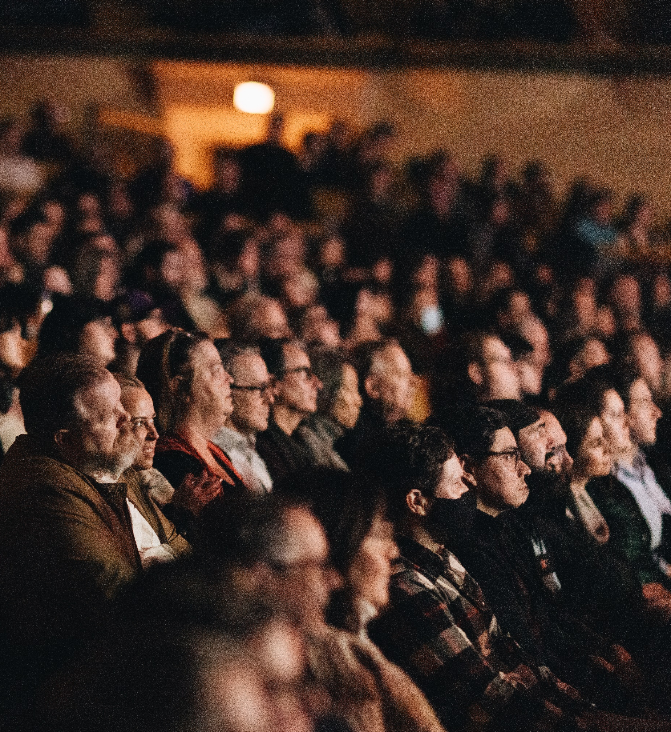
The Orchestra
Orchestra section capacity: 875 seats
Removeable Row B, reduces seating capacity by 34 seats
Accessible via main floor lobby
Two accessible seating platforms on house right and left, seating for up to six wheelchairs per platform
https://theaud.us/orchestra

Slide 6
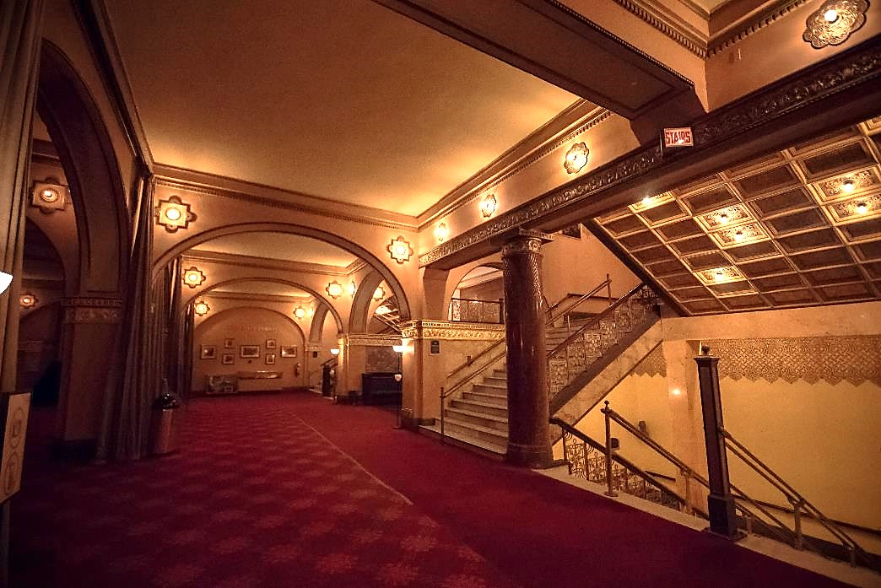
Dress Circle Lobby
Reception Capacity: 300
Seated Capacity: 150
Great atmosphere for pre- or post-show events.
Features two fully restored fireplace seating areas, perfect options for a VIP lounge or talk-backs
House curtains separate Dress Circle lobby area from Dress Circle seating section, offering a lovely reveal of the theatre for your guests as they take their seats.
https://theaud.us/DClobby

Slide 7
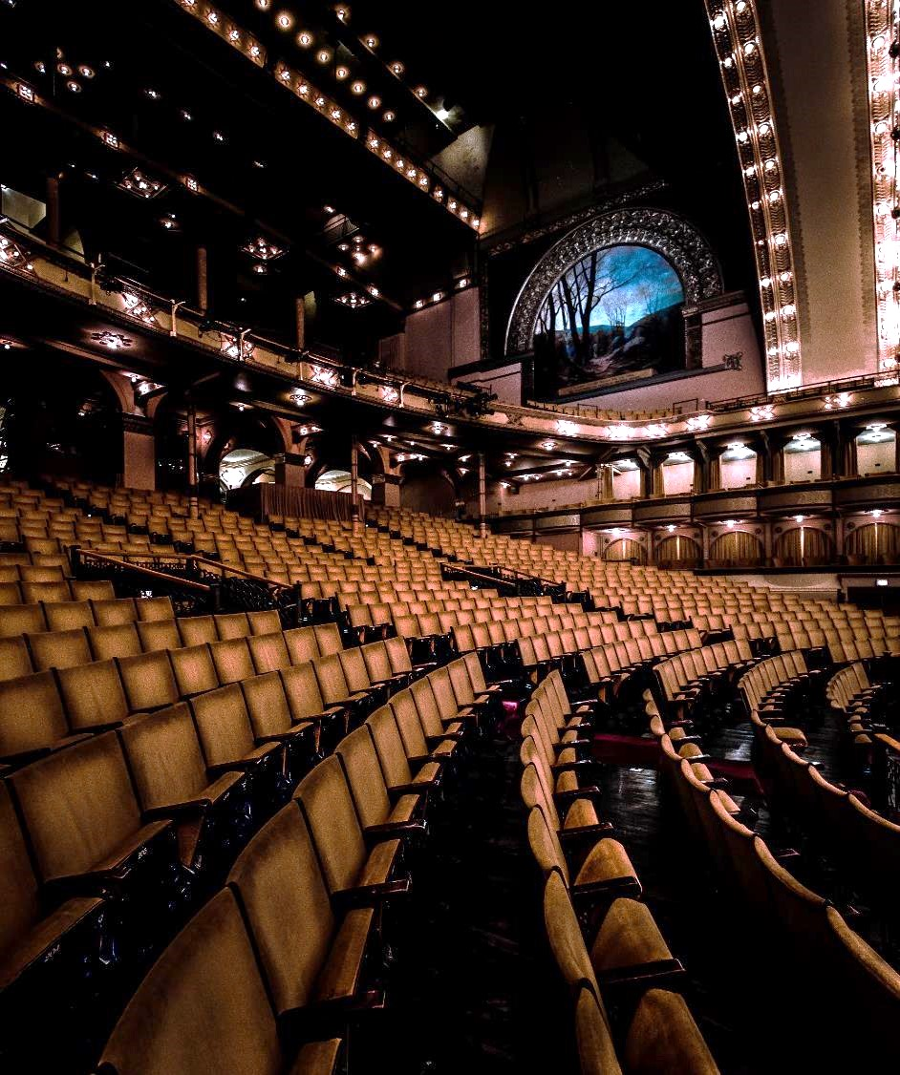
The Dress Circle
Dress Circle capacity: 425 seats
Total Capacity for Upper and Lower Boxes: 196
Standard seating of four seats per box; six seats per box available in Upper Boxes for large scale events
Accessible via Dress Circle lobby
Accessible seating platform available in the back of the 400 section (house left); seating for up to four wheelchairs.
https://theaud.us/dresscircle

Slide 8
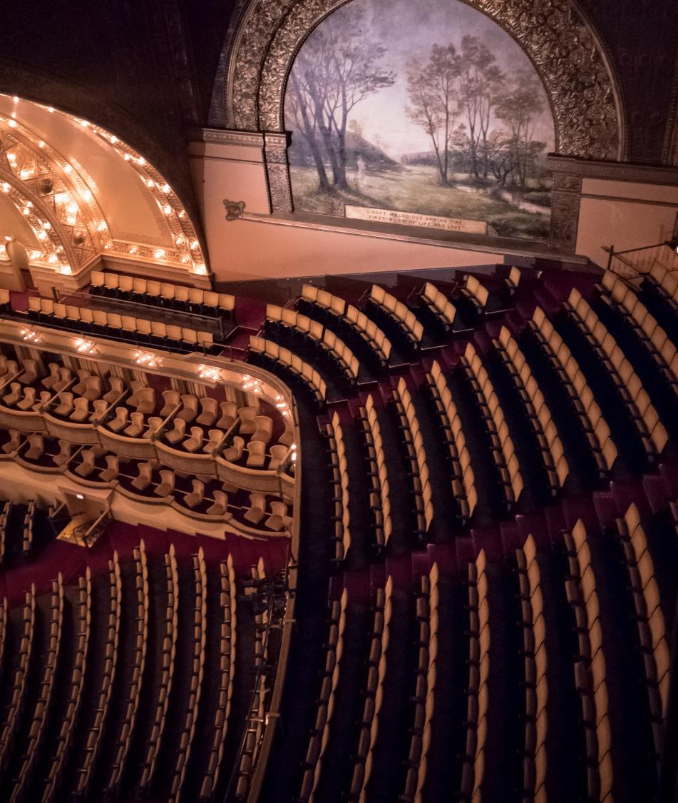
Balconies & Gallery
Total capacity of Front, Middle, and Rear Balcony: 1,401
Total capacity of Upper Balcony: 518
Total capacity of Gallery: 356
Front, Middle and Rear Balcony accessible via 3rd, 4th, and 5th floors
Upper Balcony & Gallery accessible via 6th floor
Additional restrooms available on floor 3
Additional accessible seating available of floor 5
Elevator access available on floors 1 through 6
https://theaud.us/1stbalcony

Slide 9
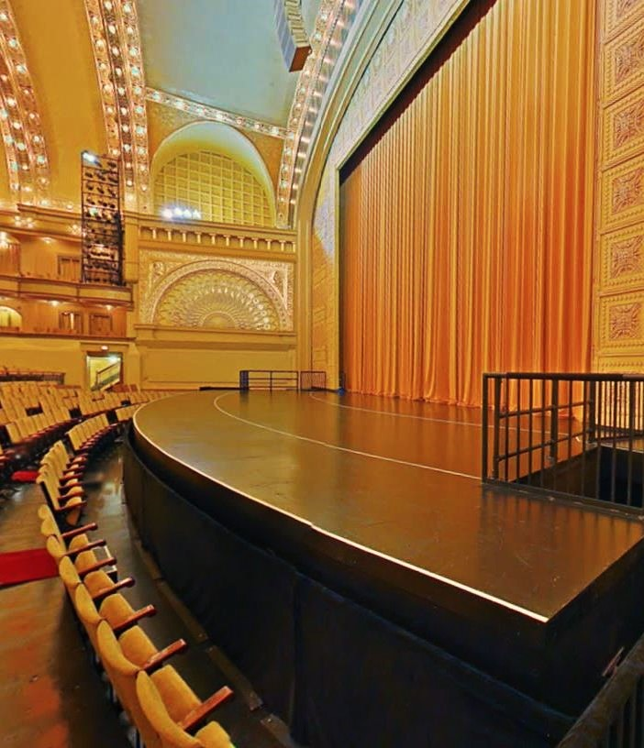
Pit Options
Pit lifts 1 and 2 are capable of moving from traditional pit height, stage height, and any height in between.
When pit lifts are at house height, max capacity for concert seating is 104; seating for 60 allows for a more comfortable seating experience.
Pit lifts at stage height are often utilized for speaking engagements in front of our main curtain.
Curved apron is 8’-1” deep at centerline.
Curved apron with pit lifts at stage height is 23’-1” deep at center line.

Slide 10
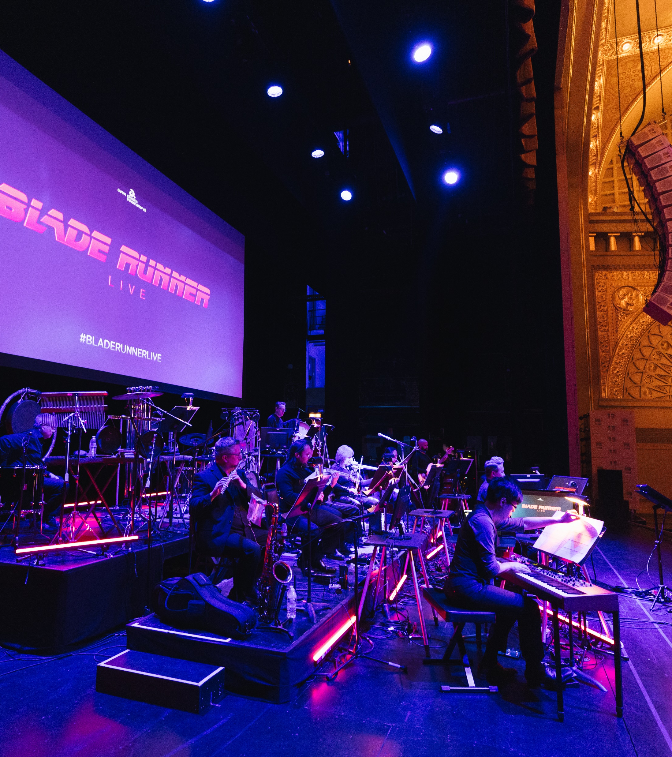
The Stage
Proscenium Dimensions:
  False proscenium: 47’-3” wide x 35’-0” high
  w/o false proscenium: 74’-11” wide x 40’-0” high
Stage Dimensions:
  60’-0” plaster line to the backwall
  54’-9” smoke pocket to last lineset
  97’-2” wide wall-to-wall
Stage Rigging:
  80’-0” fly height
  84’9” deck to the grid
  90 pipe battens, including 1 house curtain
Loading & Unloading:
  Loading dock accessible to two 53’ trucks in alleyway off of Michigan Avenue
  Loading dock door measurements
    Minimum horizontal clearance: 9’-8”
    Minimum vertical clearance: 13’-8”
A full list of technical specifications for the theater available upon request.

Slide 11
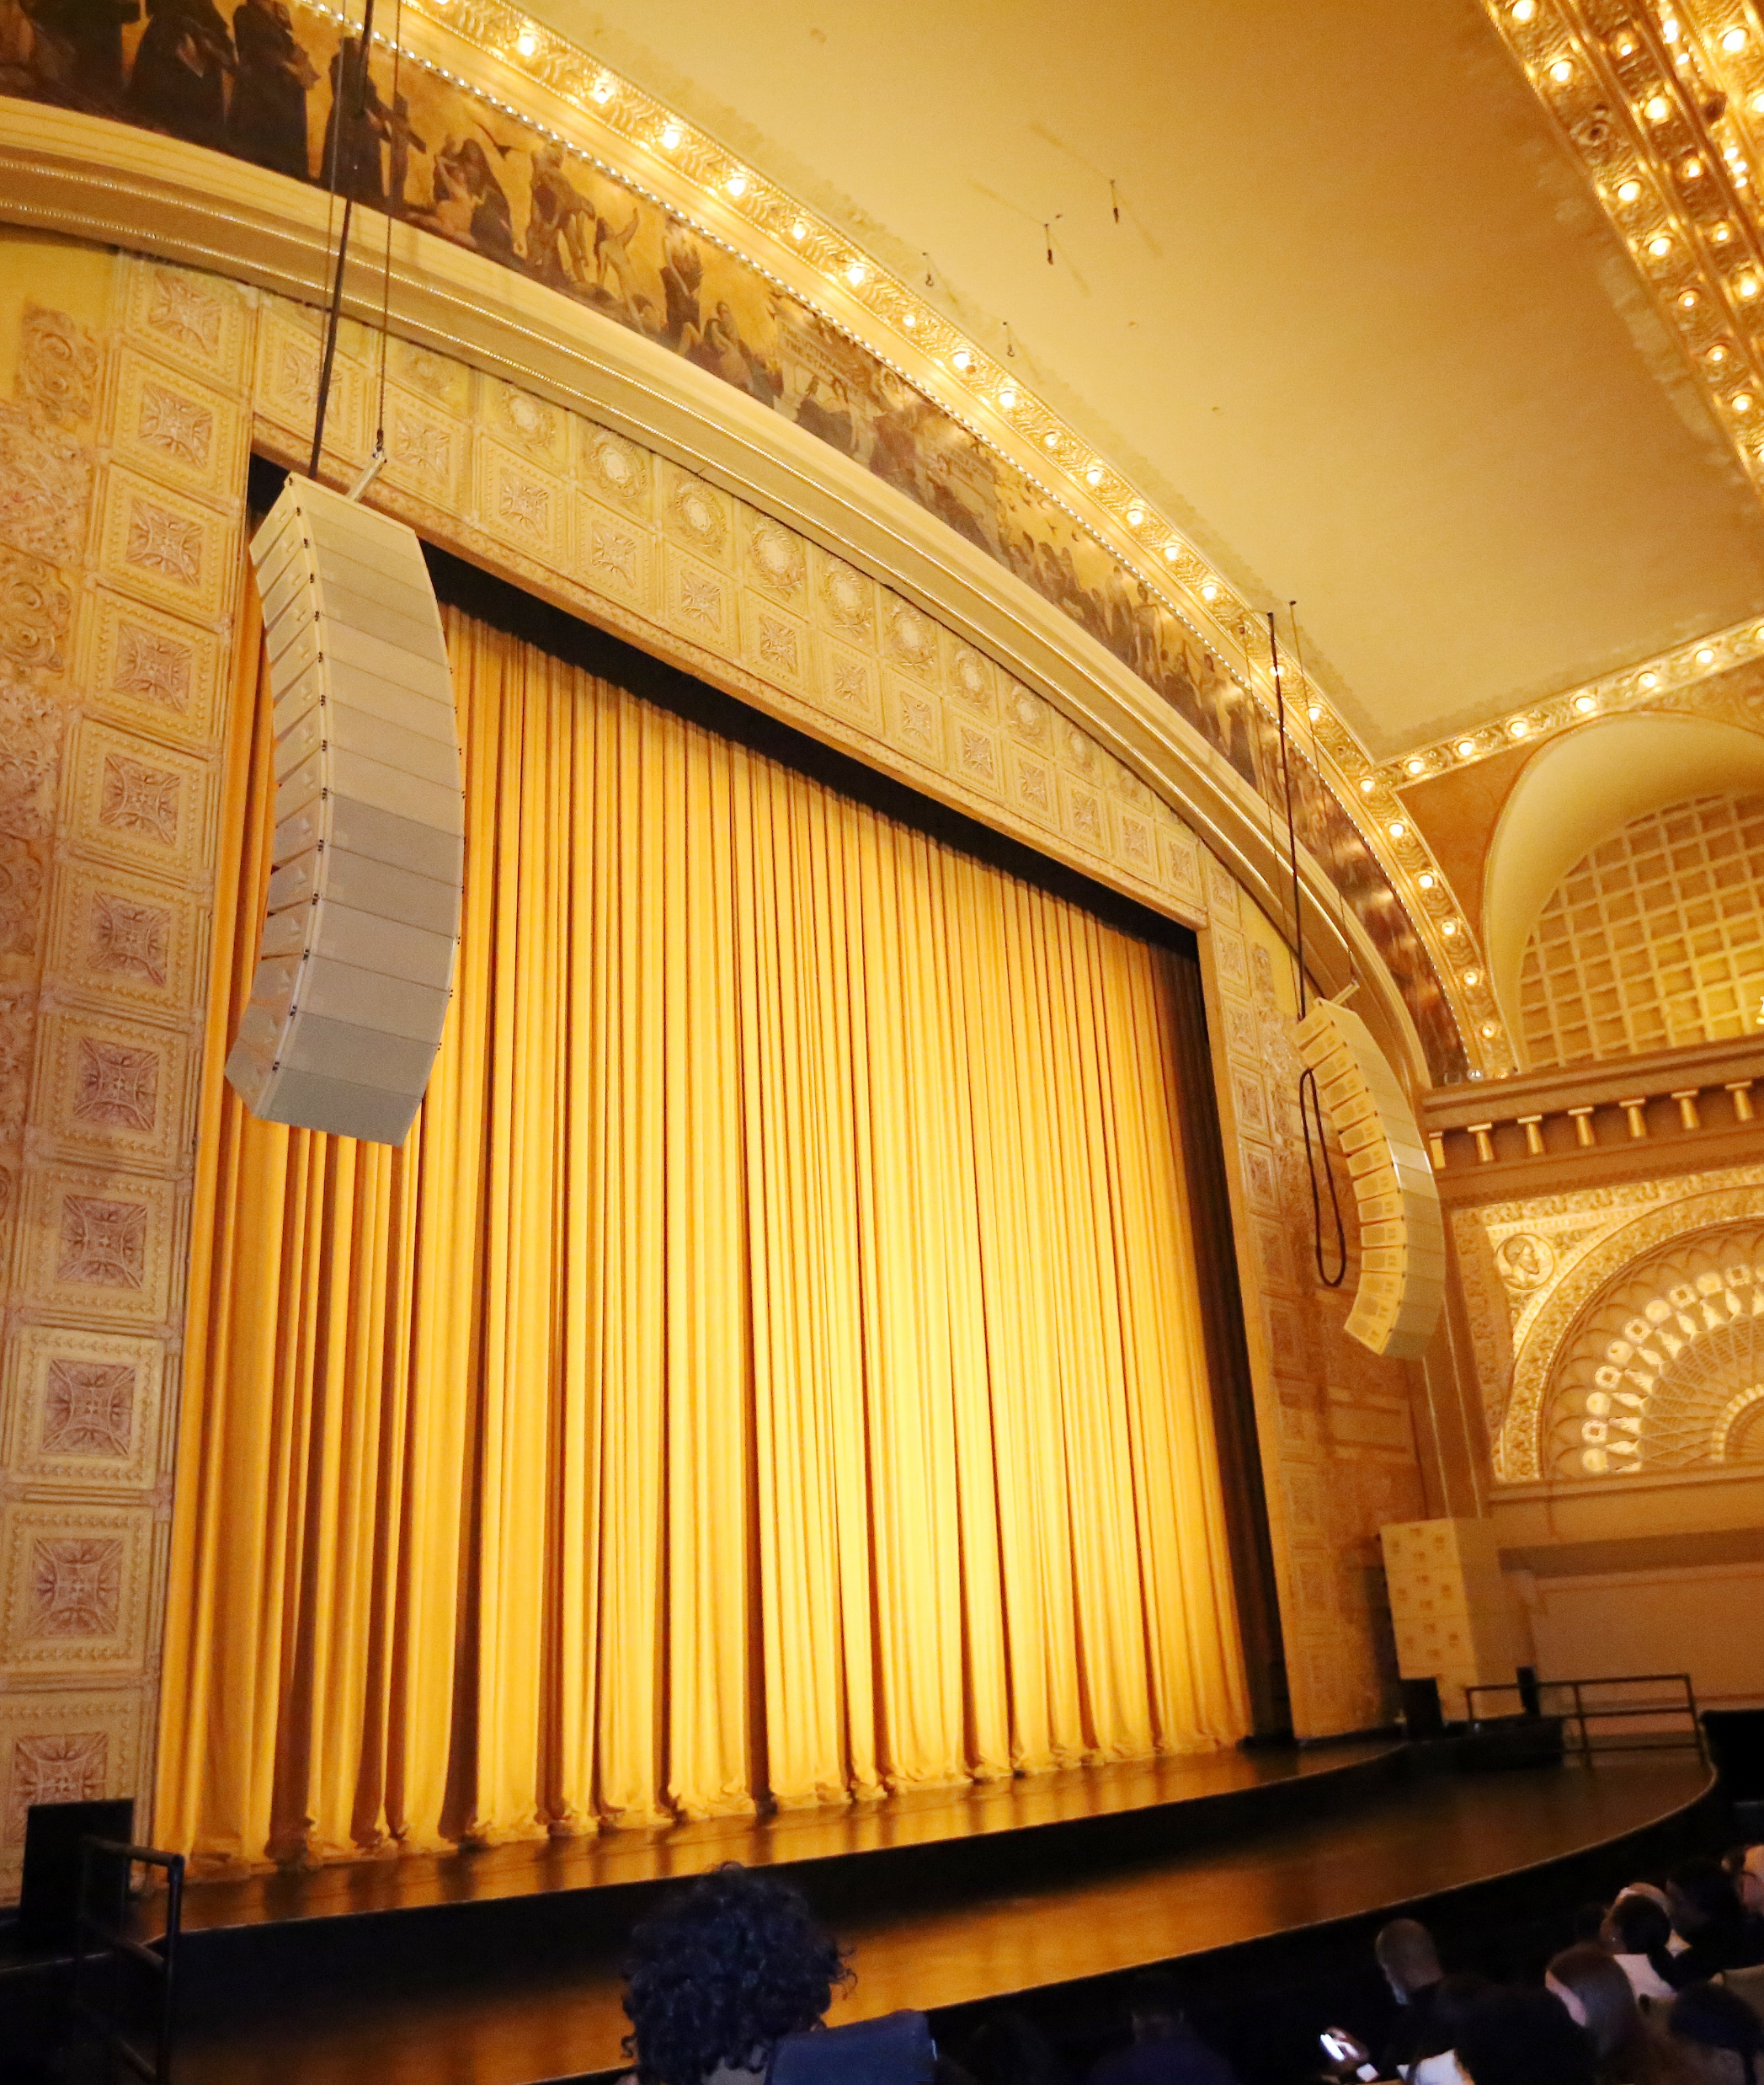
Audio Equipment
D&B System
  14 KSL Line Arrays (per side)
    (10) KSL8 Loudspeakers
    (4) KLS12 Loudspeakers
  4 GSL-Gsubs (per side)
    Ground Stacked on Stage Deck
  Front Fills
    (4) Y10P Loudspeakers
    (4) V7P Loudspeakers
Network
  Dante (run over shielded CAT-6)
Audio Delay for Upper Levels
DiGiCo Quantum 338 FOH Console
Mics
  (7) SM58, (4) SM57, (1) BETA52, (6) SM137, (2) SM18 Condenser Lecturns
Mac Mini with QLab Audio License

Slide 12
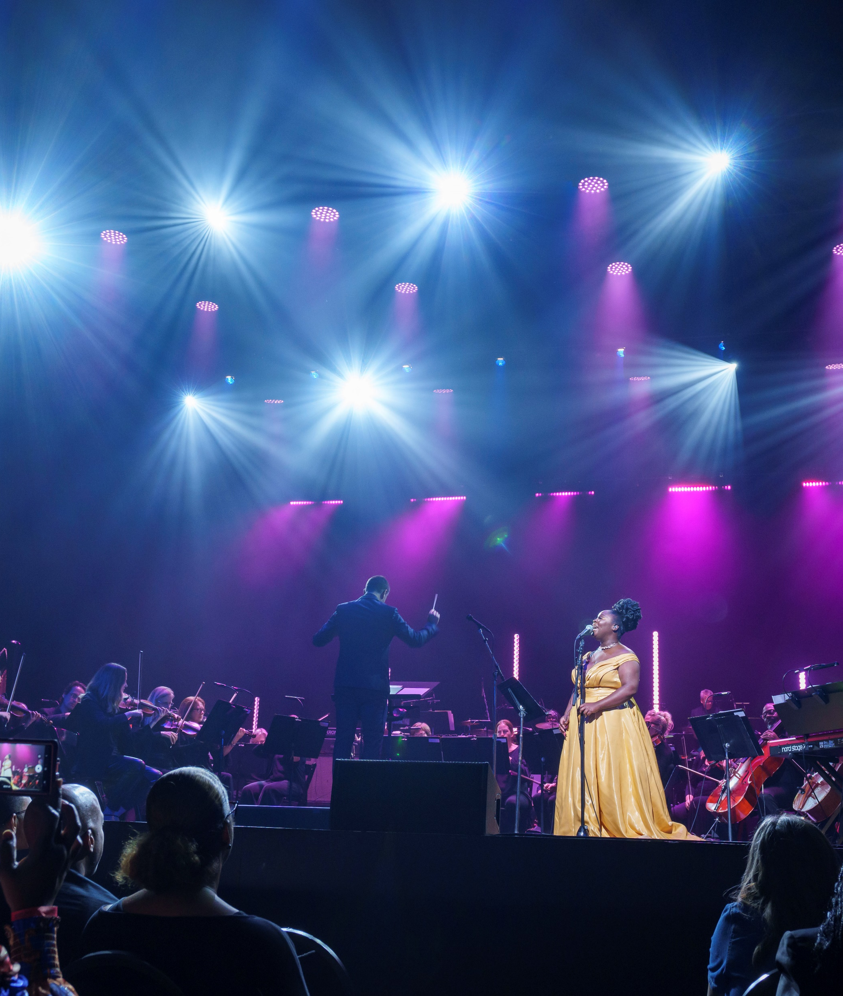
Lighting Equipment
ETC ION XE 20 2k Console
ETC Source 4 Conventional Fixtures
Intelligent Fixtures
  (24) Martin Mac Viper Performance
  (30) Martin Mac Aura PXL
  (5) Robe Megapointe
  (6) Sharpy Wash 330
  (10) Chroma-Q Color Force II 72
Radiance Hazers
(3) Spotlights
Box Booms
FOH Lighting Positions

Slide 13
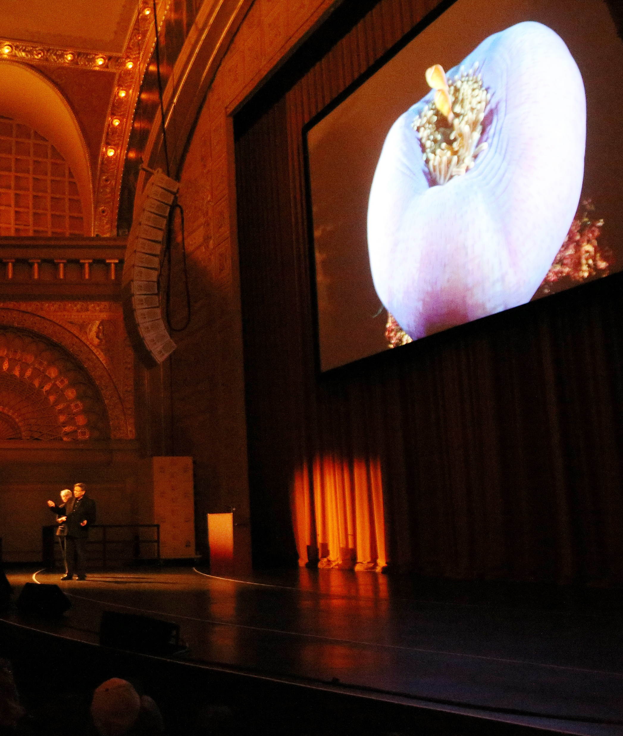
Video Equipment
(2) Barco HDX-W14 Projectors – 14,000 lumens
(1) 32’ x 18’ (16:9) Screen
(1) Crossover XCross Switcher
Switching Station Monitors (Playback, Record, Preview)
(1) Confidence Monitor
Blueray/DVD Player

Slide 14
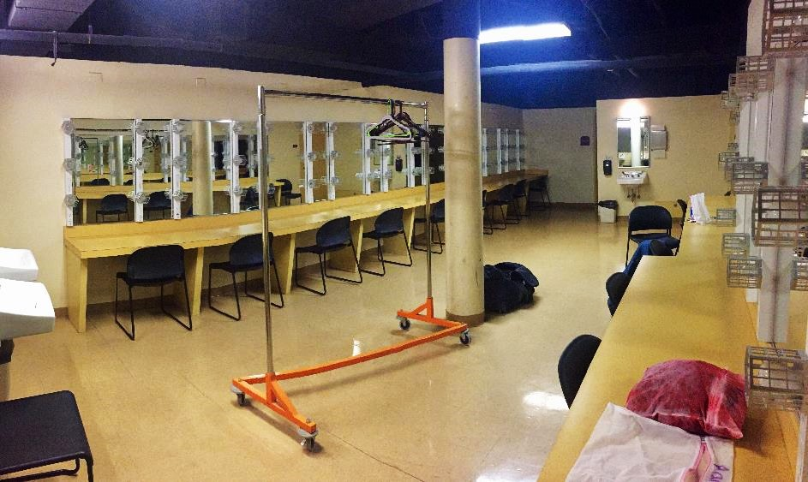
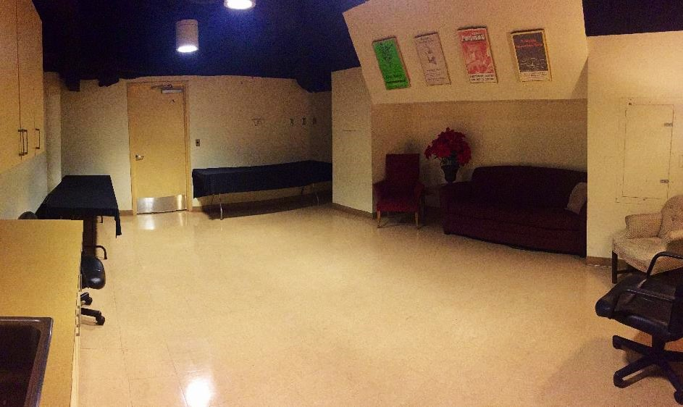
Back of House
Dressing rooms of various sizes available for both small and large performances and presentations
Men’s & women’s chorus rooms capable of holding 25 each
All dressing rooms have mirrors, sinks, toilets, and showers
Wardrobe and laundry facilities
Musicians locker room
Conductor’s room
Green Room (sofa, tables, prep counter & sink)

Slide 15
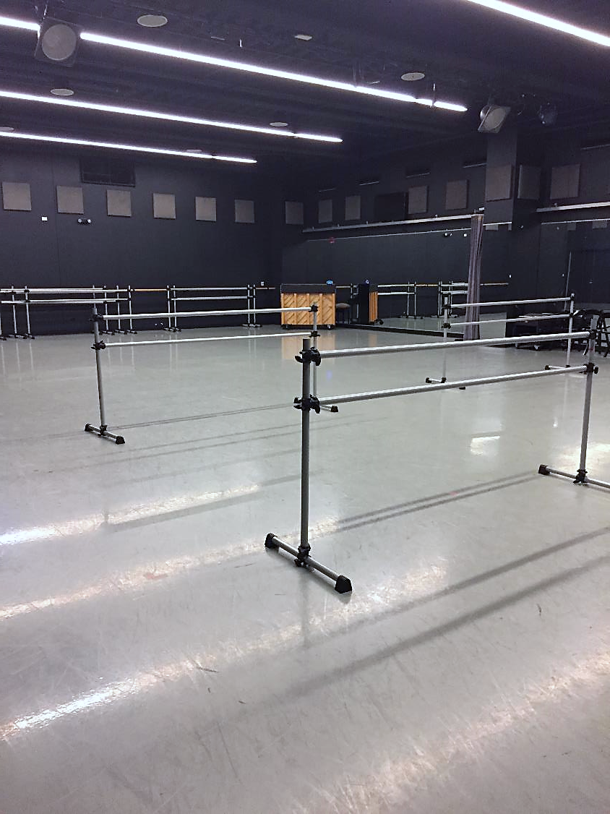
Katten/Landau Studio
The Katten/Landau Studio is adjacent to the Auditorium Theatre and is available for rehearsals, special events, and small performances.
Studio Capacity: 120 people
Accessible via Roosevelt University’s Wabash Building and the Auditorium Theatre elevator
Box Office, Production, and Front of House support available, if used for performances.
KLS may be used in conjunction with a rental of the theatre or as a standalone space.
Subject to availability. Additional rental rates may apply.

Slide 16
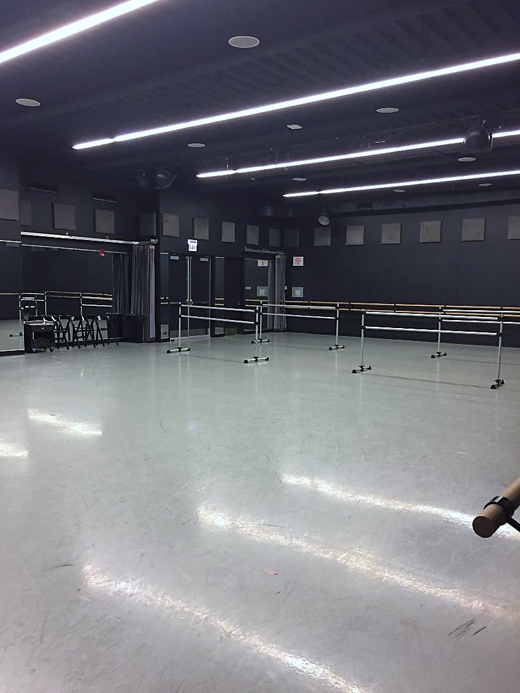
Katten/Landau Studio
Tech Specs
40’x60’ (2,400 sq ft)
Harlequin sprung dance floor & covering
1 mirrored wall w/ drapes
Wooden barres on 3 walls & 10- 8’ portable barres
Yamaha piano
Soundcraft mixer (FX16ii)
TASCAM CD player iPod dock (CD-200i)
Shure wired microphones (SM58)
Smartfade Lighting Control & ETC Expression 3 – 800 control console

Slide 17
Thank you for taking our virtual tour! For additional technical information, schematics, and photos of our spaces, please contact us at production@auditoriumtheatre.org.
To rent the Auditorium, please submit an inquiry on our website or call 312.341.2300 to be connected to a member of our team.
We hope you will consider the Auditorium Theatre for your next event!

